Slide 1






@Cartoon resource::贪吃蛇大作战
Presented by: Group One
Ouch,Keep Alive
Ouch,Keep Alive
PU MIHAN、CHEN LONG、CHEN YANG

Slide 2

Content
A
B
C
Frame
work
Detail
schedule
How to build
How to work
How to fun

Slide 3

Framework
All important geometries
Snake
Resource
Border

Slide 4
Framework
interactions
Crash
Against the wall

Slide 5

WORK
1.Basic control
2.Snake touch bounds and born again
3.Resource will put in the map randomly
4.Camera move with player’s snake

Slide 6

Schedule
Until now:
We have finished basic operates of players’ snakes and scenes. Player can control snakes simply.
Friday:
Our game will almost finish . And you may play in Friday
Tuesday:
You will see the whole game and play it. Hope you will love it!

Slide 7

Ouch,Keep Alive
Ouch,Keep Alive
Old game, New Feeling
Wait for you!

Slide 8
WORK
Energy.js
this.energyMap() --store the position of resource
RandomSet() --initialize the resource position
RandomUpdate() --update the new resource to Map
Change() --change the resource to null
getSum() --record the total resource
Produce() --create new resouce

Slide 9
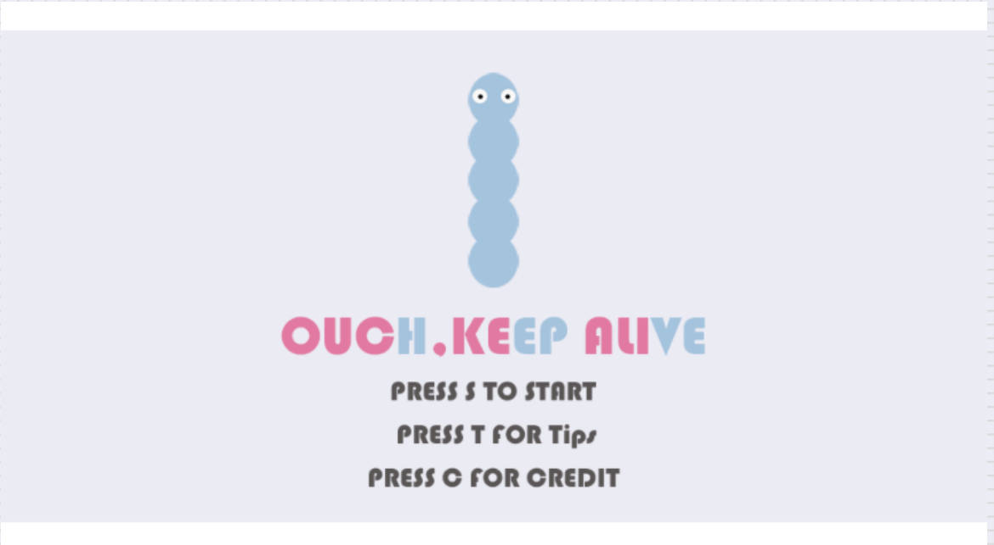
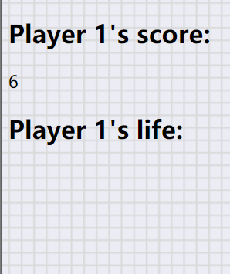
Presented by: Group One
PU MIHAN、CHEN LONG、CHEN YANG
Ouch,Keep Alive
Ouch,Keep Alive
@Cartoon resource::贪吃蛇大作战

Slide 10
Presented by: Group One
PU MIHAN、CHEN LONG、CHEN YANG
@Cartoon resource::贪吃蛇大作战

